Slide 1
Deep Learning
explained
A short introduction
(As it’s an internal seminar, most of the slides were unceremoniously copied from the web)

Slide 2
First, what is Machine Learning?
Machine learning is an application of artificial intelligence (AI) that provides systems the ability to automatically learn and improve from experience without being explicitly programmed.

Slide 3
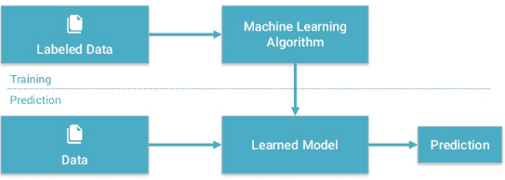
First, what is Machine Learning?

Slide 4

Then what is Deep Learning?
Deep learning is a class of machine learning algorithms that:
use a cascade of multiple layers of nonlinear processing units for feature extraction and transformation. Each successive layer uses the output from the previous layer as input.
learn in supervised (e.g., classification) and/or unsupervised (e.g., pattern analysis) manners.
learn multiple levels of representations that correspond to different levels of abstraction; the levels form a hierarchy of concepts.

Slide 5
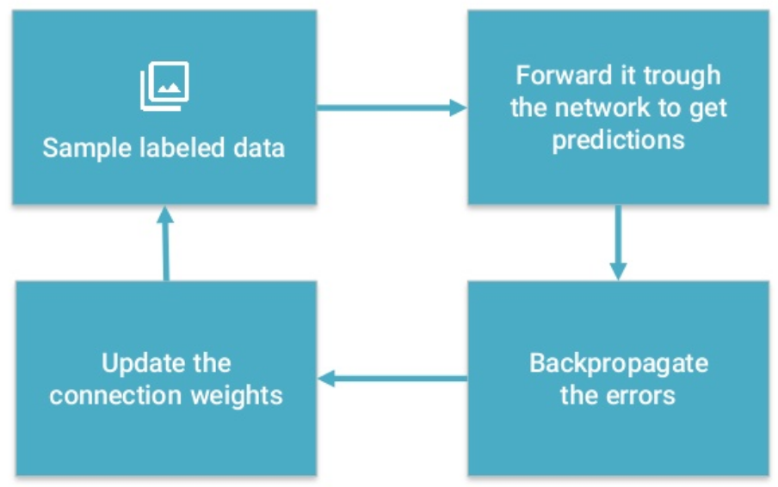
Deep Learning training process

Slide 6
Where is Deep Learning used?
Previously all these fields were dominated by custom algorithms and theories:
Speech Recognition
Computer Vision
Natural Language Processing
But since 2012 everything changed:
“One net to rule them all”

Slide 7
What changed?
Neural networks were invented in the 1960s. Three things were missing back then:
Big Data
Computational resources (Moore’s Law, GPUs)
Algorithmic Progress

Slide 8
Deep Learning Basics
Usage requirements:
Large data set with good quality. MUCH larger than previous ML methods.
Measurable and describable goals. Define the costs, classify the image, etc.
Enough computing power for training (GPUs). Further inference is MUCH cheaper.
Excels in tasks where basic unit (pixel, word) has very little meaning by itself, but the combination of such units has useful meaning.

Slide 9
Deep Neural Network Architectures
Main types:
Recurrent neural network (RNN): data can flow in any direction, used for applications such as language modeling, speech recognition. Long short-term memory (LSTM) and Gated recurrent units (GRUs) are most popular.
Convolutional neural network (CNN): are used mainly in computer vision. Typically consist of a series of convolutional layers, pooling layers, and fully connected layers.

Slide 10
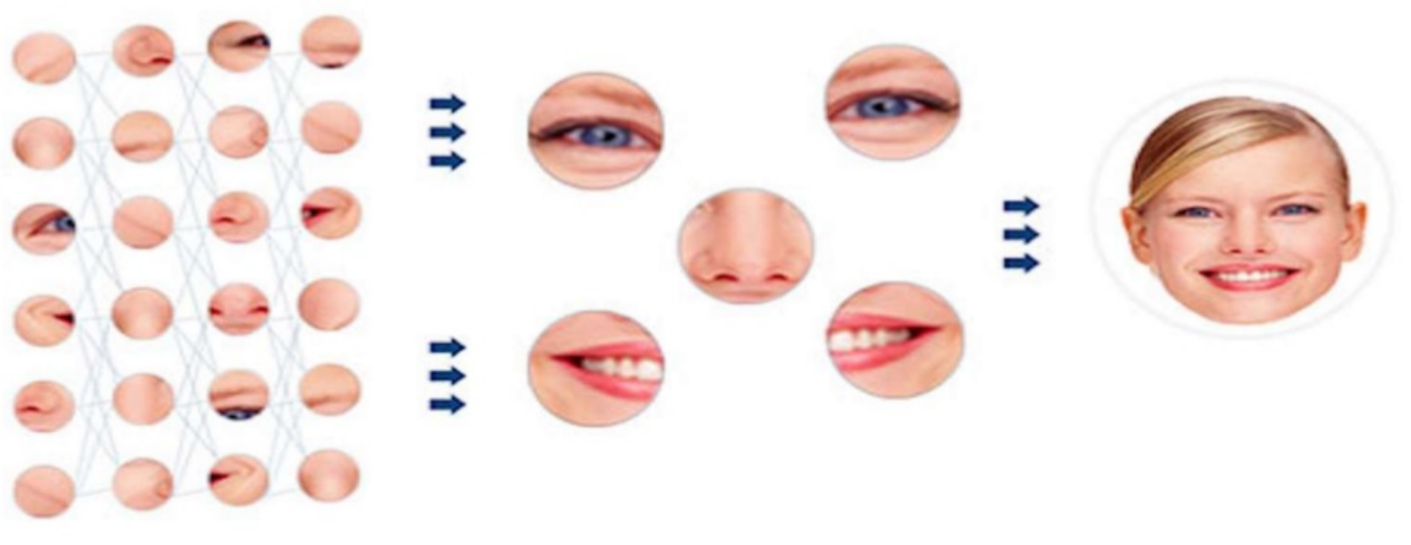
What happens in those CNN layers?

Slide 11
Offtopic: Moravec’s Paradox
"...contrary to traditional assumptions, high-level reasoning requires very little computation, but low-level sensorimotor skills require enormous computational resources."
We should expect the difficulty of reverse-engineering any human skill to be roughly proportional to the amount of time that skill has been evolving in animals.
The oldest human skills are largely unconscious and so appear to us to be effortless.
Therefore, we should expect skills that appear effortless to be difficult to reverse-engineer, but skills that require effort may not necessarily be difficult to engineer at all.

Slide 12
Deep Learning Problems: Next AI winter
From Wikipedia:
“In the history of artificial intelligence, an AI winter is a period of reduced funding and interest in artificial intelligence research. The term was coined by analogy to the idea of a nuclear winter. The field has experienced several hype cycles, followed by disappointment and criticism, followed by funding cuts, followed by renewed interest years or decades later.”
Some researchers believe we’ve reached the limits of the current era of hardware DNN architectures. The biggest breakthroughs in 2018 happened due to increase of layers or GPUs.

Slide 13
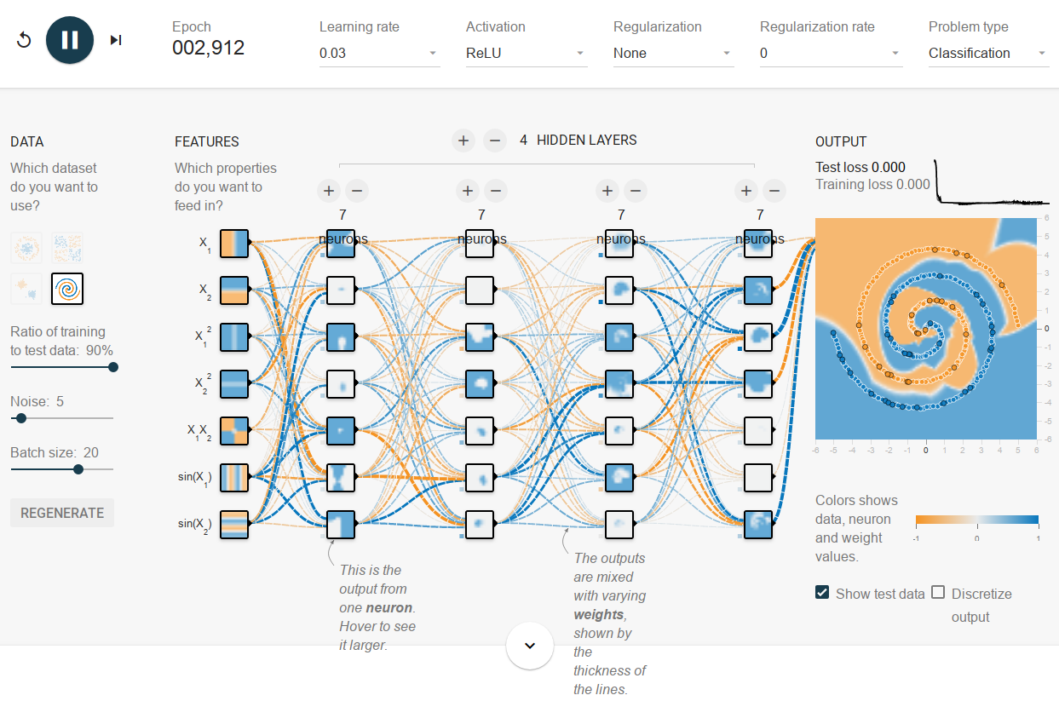
A Neural Network Playground
A nice tool to play with different parameters:
https://playground.tensorflow.org

